Slide 1
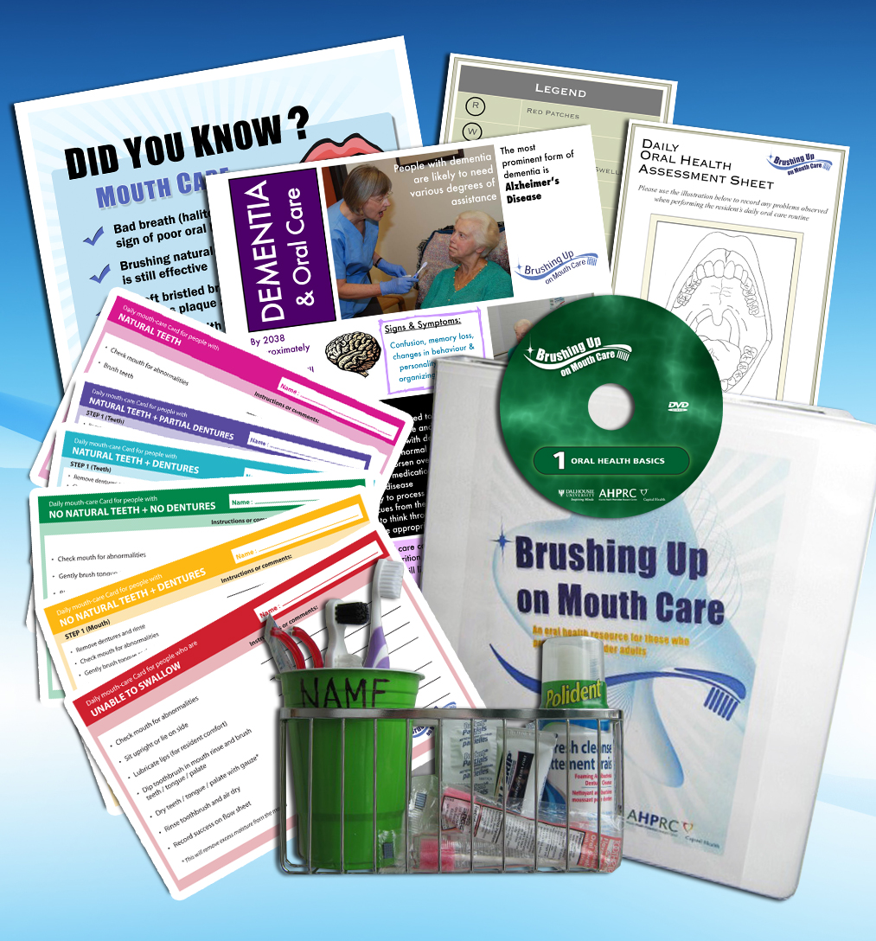
Tutorial
Brushing Up on Mouth Care:
Online Program
What It Is, What Is Included, How to Navigate the Website
Notes:
1
This presentation will outline the ‘Brushing Up on Mouth Care’ program including details on what it is, where it originated from, its intended audience, what it includes, how to use it, and what you can expect by using the program.

Slide 2
Tutorial
Brushing Up on Mouth Care: Online Program
What Is It?
An initiative that facilitates the delivery of optimal daily mouth care for individuals who may require assistance with their personal care
Many open-access resources available!
Notes:
The ‘Brushing Up on Mouth Care’ program facilitates the delivery of optimal daily mouth care for individuals who may require assistance with their personal care. The program achieves this goal by providing a wealth of open-access resources that assists its users on a variety of topics such as oral health assessments, oral care planning, care cards, and oral care product use.

Slide 3
Tutorial
Brushing Up on Mouth Care: Online Program
Origins
Developed from an earlier research project conducted by Dalhousie University (2008-2012) which examined oral care in continuing care facilities in Nova Scotia
Results: lack of awareness and education on oral health contribute to higher rates of oral disease in this population
Notes:
The program arose from an earlier study, associated with Dalhousie University, which examined oral care in continuing care facilities in Nova Scotia. Results from this study demonstrated that there is a lack of awareness and education surrounding the importance of oral health in nursing homes and long-term care facilities. With an aging population, this is less than ideal given that there is a well-established relationship between oral health and overall health.

Slide 4
Tutorial
Brushing Up on Mouth Care: Online Program
Relevance
Optimal oral health is important for the health and wellbeing of all individuals, but particularly for those who are frail and/or have neurological conditions
Many negative implications associated with poor oral health
There is a need for non-dental health professionals to be knowledgeable and proficient in providing daily mouth care
Notes:
As such, this initiative is particularly important for individuals who are frail and/or have neurological conditions. Individuals with such conditions are especially susceptible to acquiring oral diseases since they often rely on others to help maintain their personal care. Oral diseases can lead to pain, discomfort, an inability to chew, swallow or engage in social activities. Oral diseases may also have negative implications on one’s nutritional status and other health concerns like diabetes and aspiration pneumonia. Likewise, since older adults seem to be maintaining their natural teeth throughout their entire life, there is a critical need for continuing care staff to be knowledgeable and proficient in providing optimal oral health care.

Slide 5
Tutorial
Brushing Up on Mouth Care: Online Program
Intended Audience
Care Providers
Administrators/Policy Makers
Health Care Educators
Friend and Family Caregivers
Notes:
That said, although the program is largely intended for care providers such as nurses, continuing care assistants, and personal care workers, the program may also benefit a variety of other audiences. These include policy makers and administrators, health care educators, and family and friend caregivers. Note, however, that since the program can be used by a variety of audiences, you do not need to use the program in its entirety. You may choose to use the resources that are most applicable to your specific needs.

Slide 6
Tutorial
Brushing Up on Mouth Care: Online Program
Additional Notes
Do not modify the Brushing Up resources from their current formats
Do not reproduce the materials for commercial profit
Acknowledge that BrushingUp.ca is the source
Notes:
Additionally, we ask you to please note the following:
We ask that the Brushing Up resources not be modified from their current formats
We ask that you do not reproduce the materials for commercial profit
And we ask that BrushingUp.ca is acknowledged as the source

Slide 7
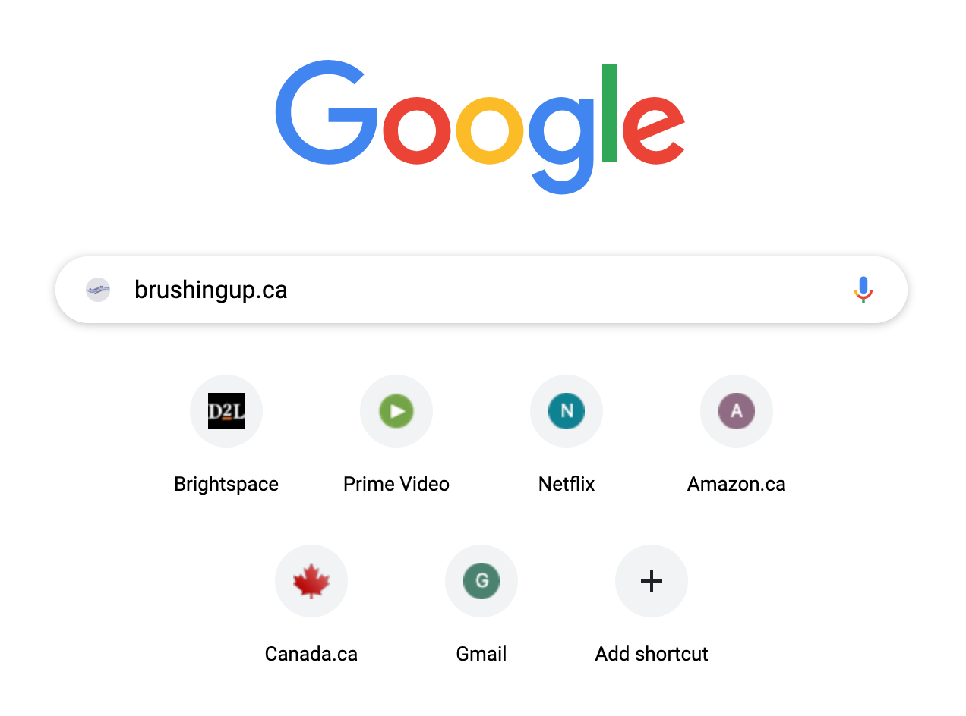
Tutorial
Brushing Up on Mouth Care: Online Program
Introducing the Online Program
Website: http://brushingup.ca/
Notes:
The online version of ‘Brushing Up on Mouth Care’ can be accessed by using the link brushingup.ca. To do this, we will enter the website (brushingup.ca) into our search engine. We recommend that you use either Google Chrome or Firefox when making this search because it ensures that all package materials download in the proper format.

Slide 8
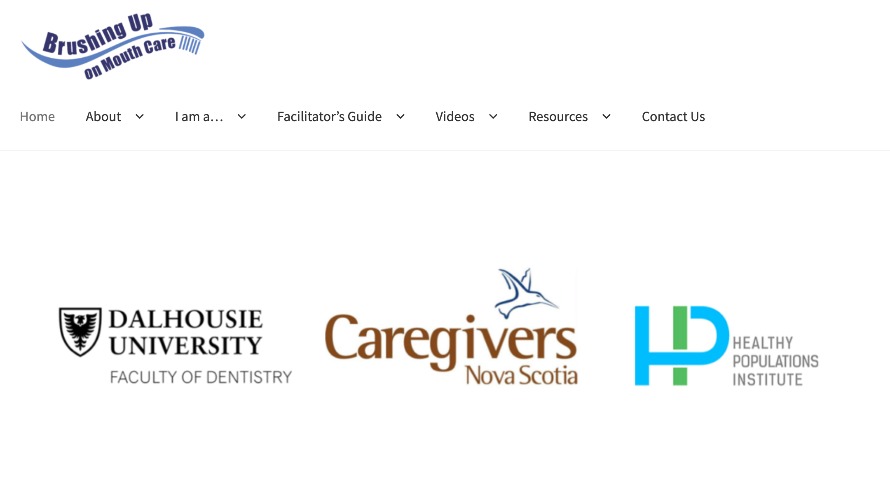
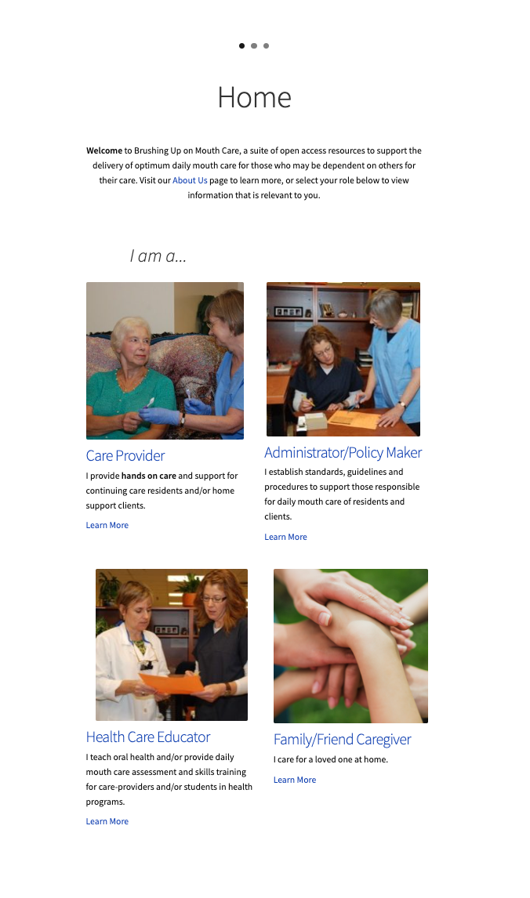
Tutorial
Brushing Up on Mouth Care: Online Program
Homepage
Notes:
Once we enter the website into either Google Chrome or Firefox, we will be brought to the homepage of ‘Brushing Up on Mouth Care’. Here, you will see a list of horizontal tabs along the top of the screen, as well as a list of the institutions and organizations associated with the program. As you scroll down, you will also see that there are quick links to understanding what the ‘Brushing Up on Mouth Care’ program is and the relevant materials for each targeted audience. We will explore these ‘quick links’ in the following slides.

Slide 9
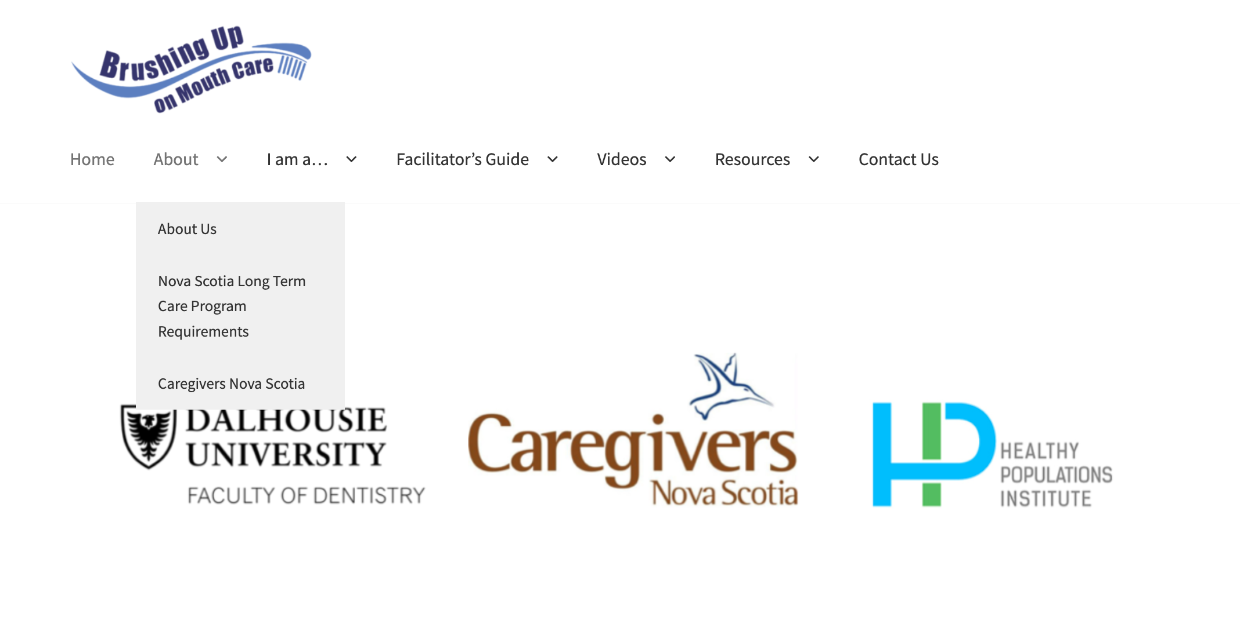
Tutorial
Brushing Up on Mouth Care: Online Program
Tab #1: ‘About’
Notes:
The first main tab, ‘About’, serves as a prelude to the ‘Brushing Up on Mouth Care’ initiative. There are three sub-tabs that we will explore.

Slide 10
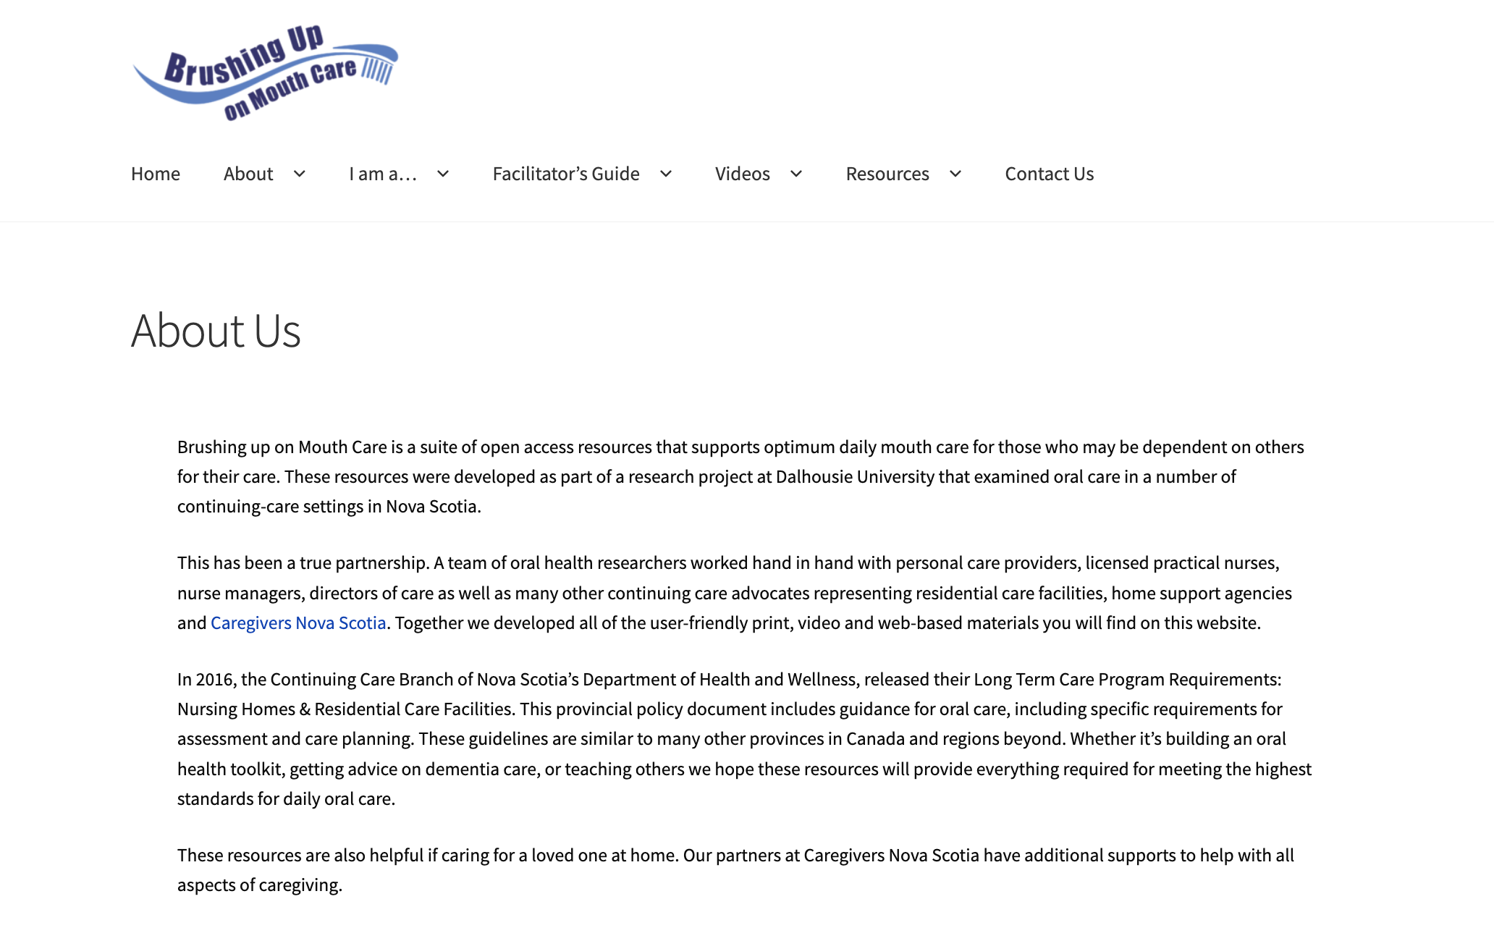
Tutorial
Brushing Up on Mouth Care: Online Program
Sub-tab: ‘About Us’
Notes:
Clicking on ‘About Us’ will provide you with the origins and importance of the ‘Brushing Up on Mouth Care’ initiative. Acknowledgement of the associated partnerships are also included in this section.

Slide 11
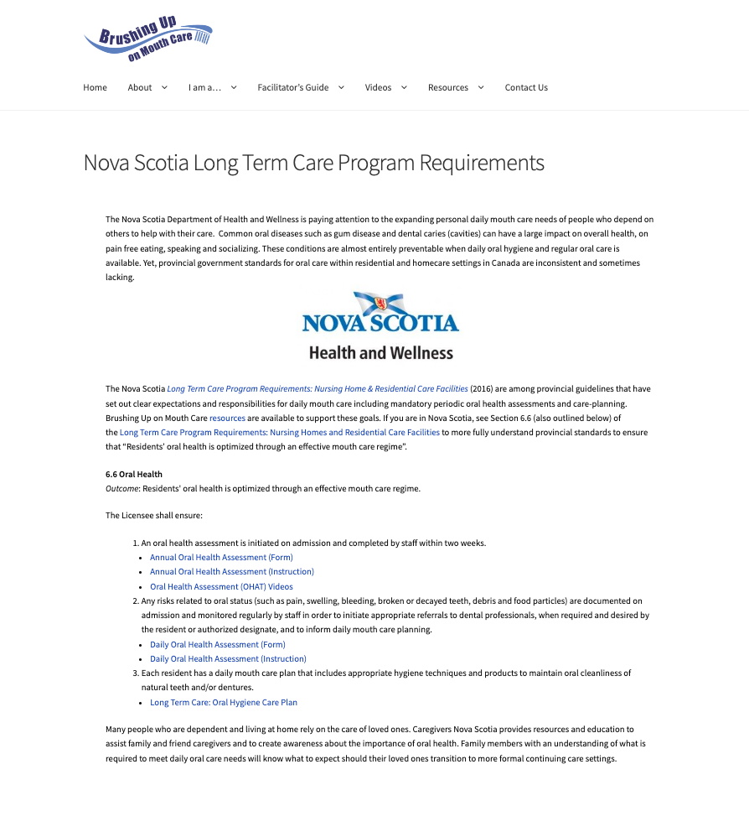
Tutorial
Brushing Up on Mouth Care: Online Program
Sub-Tab: Nova Scotia Long Term Care Requirements
Notes:
Next, we will explore the Nova Scotia Long Term Care Requirements. By clicking on this sub-tab, you will be provided with the provincial guidelines regarding the roles, responsibilities, and expectations for daily mouth care in continuing care facilities. These responsibilities are explicitly outlined on this page but can also be found in section 6.6 of the full document. A link to this full document is circled in red.

Slide 12
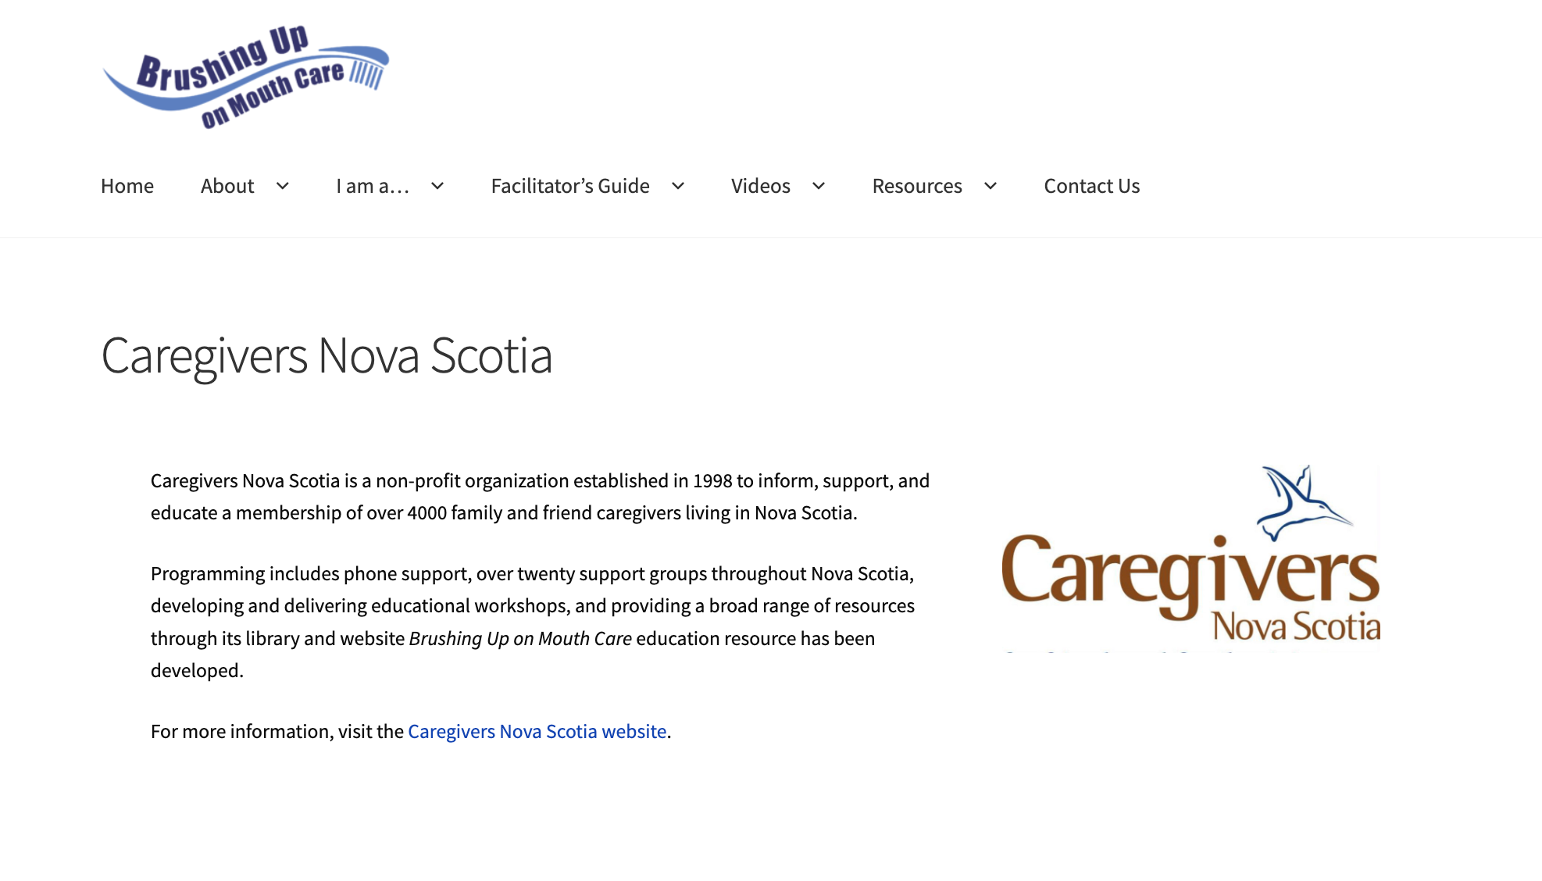
Tutorial
Brushing Up on Mouth Care: Online Program
Sub-Tab: Caregivers Nova Scotia
Notes:
Now we will learn a bit about Caregivers Nova Scotia. By clicking on this sub-tab, you will be provided with a brief introduction to what Caregivers Nova Scotia is and what kind of services they offer. Although the write-up is brief, additional details can be found on the Caregivers Nova Scotia website.

Slide 13
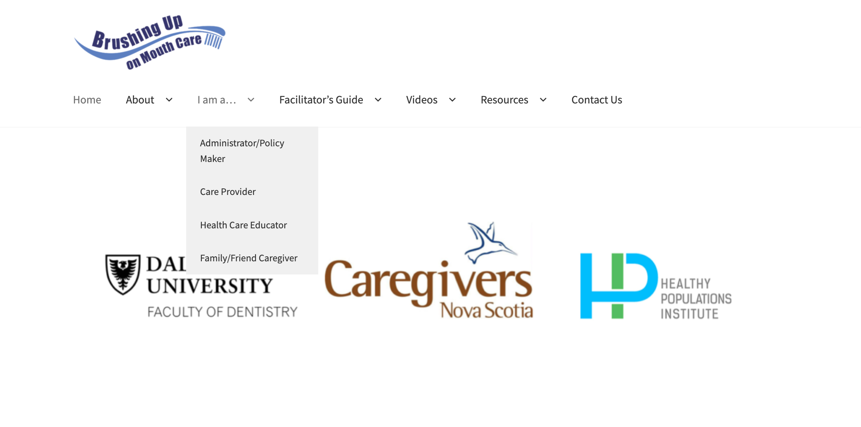
Tutorial
Brushing Up on Mouth Care: Online Program
Tab #2: ‘I Am A…’
Notes:
Moving onto the next main tab, entitled ‘I Am A…’, you will see that there are four different sub-tabs you can choose from. The sub-tab you choose will be based on your role toward the patient and/or loved one, but for the purposes of this tutorial, we will look at all four.

Slide 14
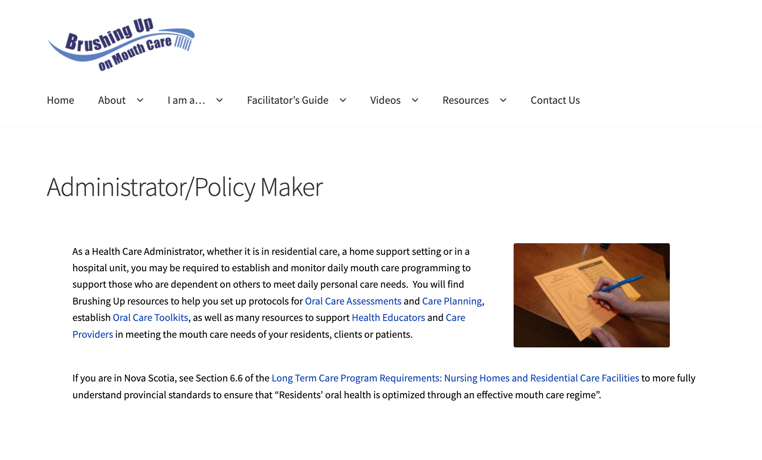
Tutorial
Brushing Up on Mouth Care: Online Program
Sub-Tab: Administrator/Policy Maker
Notes:
Clicking on ‘administrators and policy makers’, you will find that these individuals are most concerned with establishing protocols surrounding oral health activities. For this reason, these individuals are most likely to use the materials pertaining to oral health assessments and care planning. These individuals may also need to frequently reference the document entitled ‘Long-Term Care Program Requirements for Nursing Homes and Residential Care Facilities.’

Slide 15
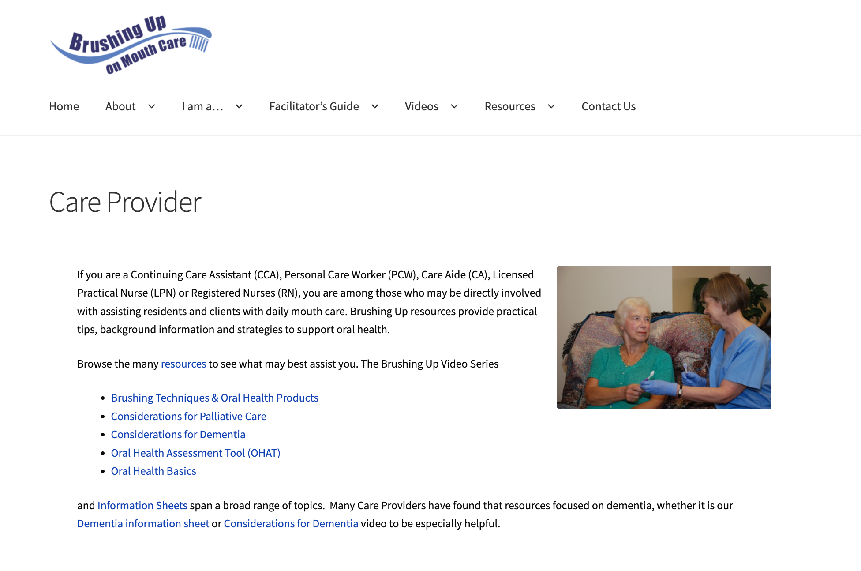
Tutorial
Brushing Up on Mouth Care: Online Program
Sub-Tab: Care Provider
Notes:
Clicking on ‘care providers’, you will find that these individuals are encouraged to review all the PowerPoints, videos, and information sheets. Using all these materials ensures that care providers achieve a strong understanding of the importance of oral health and optimal daily mouth care. Doing so also ensures that care providers are able to properly assess the oral cavity and are able to determine an appropriate care plan.

Slide 16
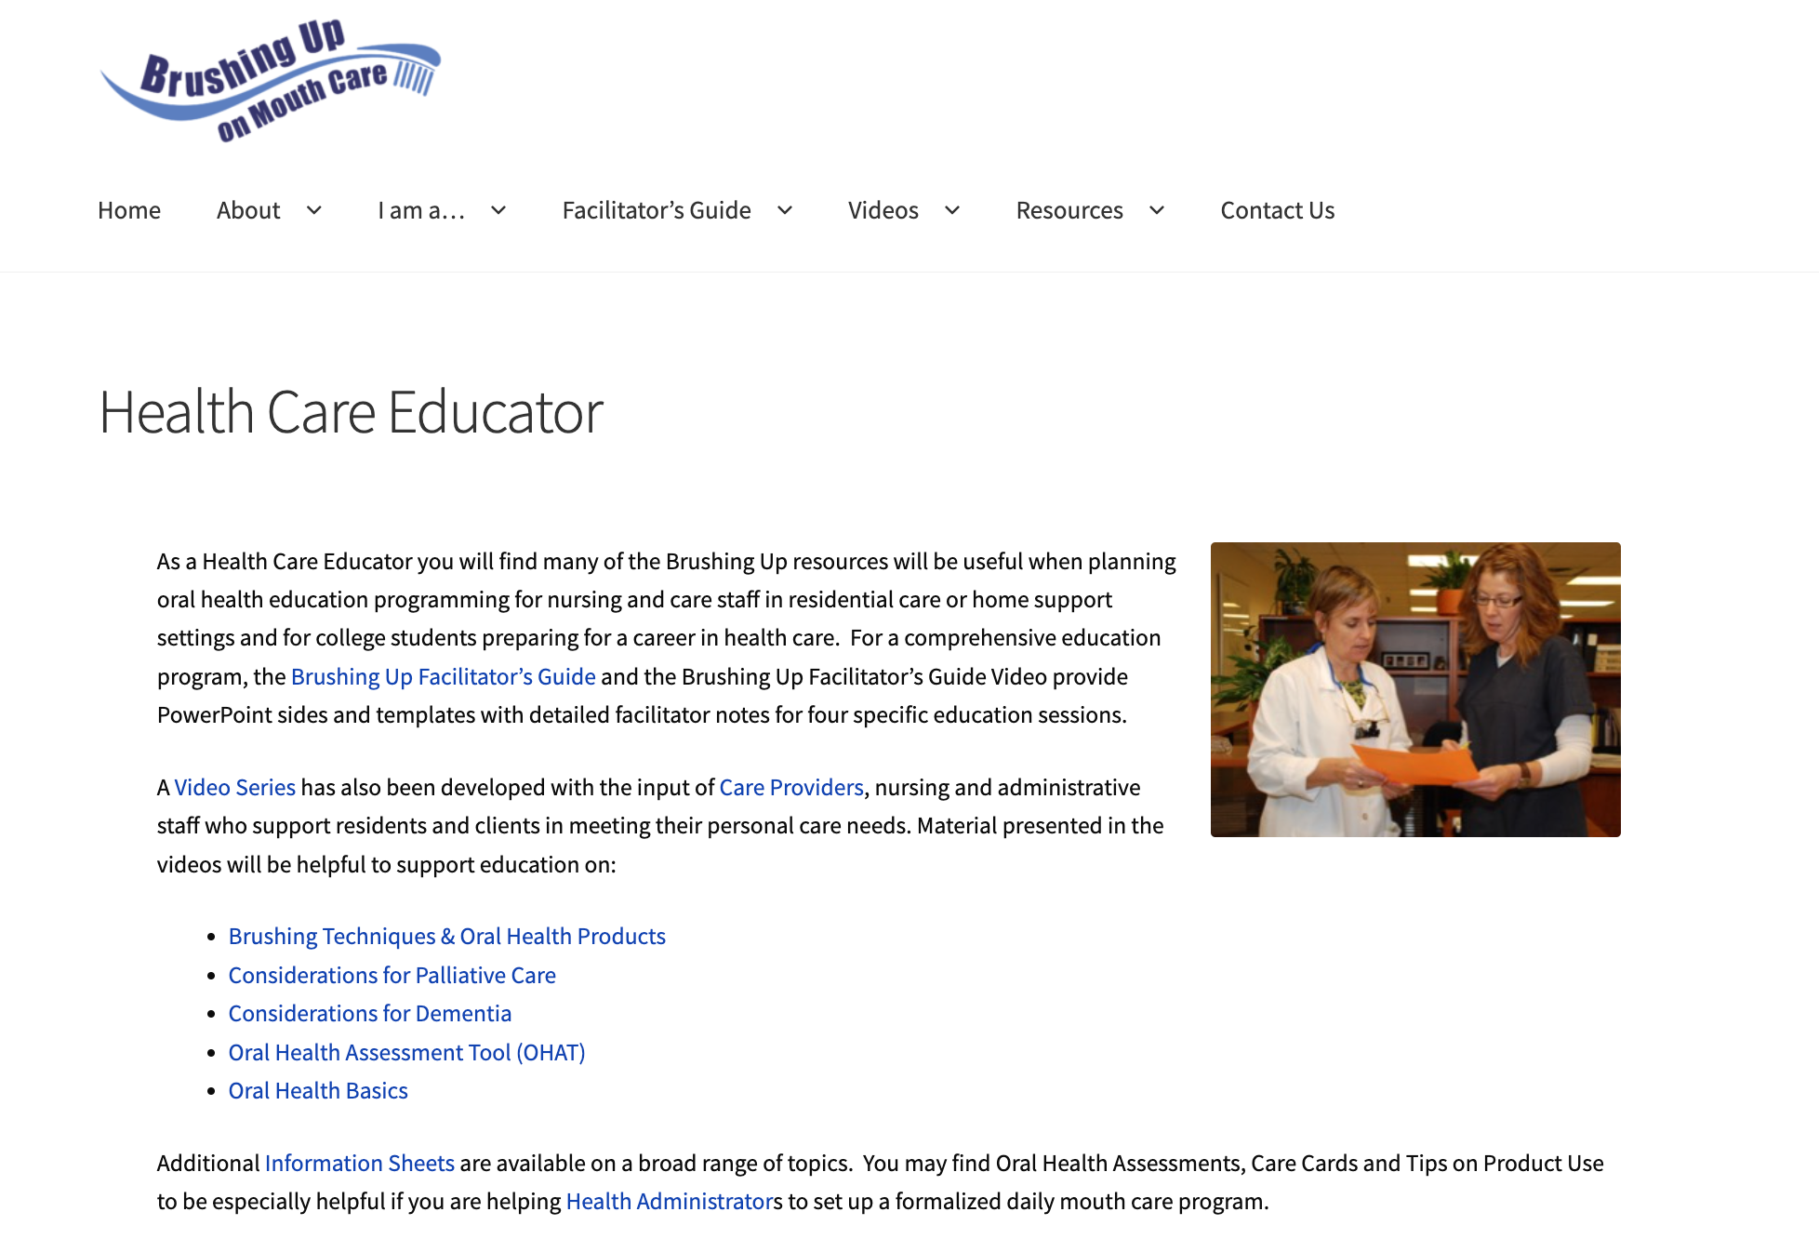
Tutorial
Brushing Up on Mouth Care: Online Program
Sub-Tab: Health Care Educator
Notes:
Clicking on ‘health care educators’, you will find that these individuals use similar resources as the care providers. This is to ensure they are well equipped to lead the five oral health and daily mouth care educational sessions. Health care educators may also access a ‘Brushing Up Facilitator’s Guide’. This guide provides additional guidance on how to facilitate educational sessions and address outstanding questions.

Slide 17
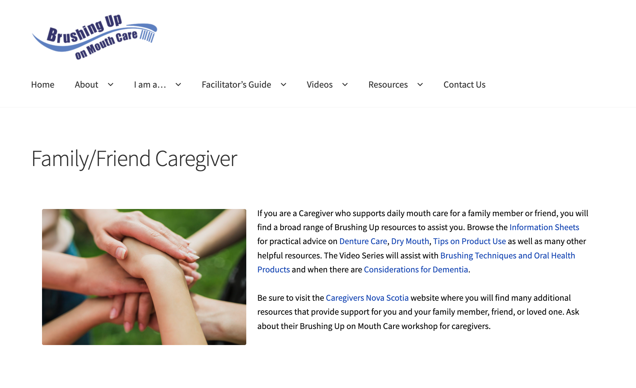
Tutorial
Brushing Up on Mouth Care: Online Program
Sub-Tab: Friend/Family Caregiver
Notes:
Lastly, clicking on ‘friend and family caregivers’, you will find that these individuals may benefit most by reading the information sheets and tips regarding oral health product use. The videos related to teeth brushing, dentures, and dementia may also help guide your learning experience.

Slide 18
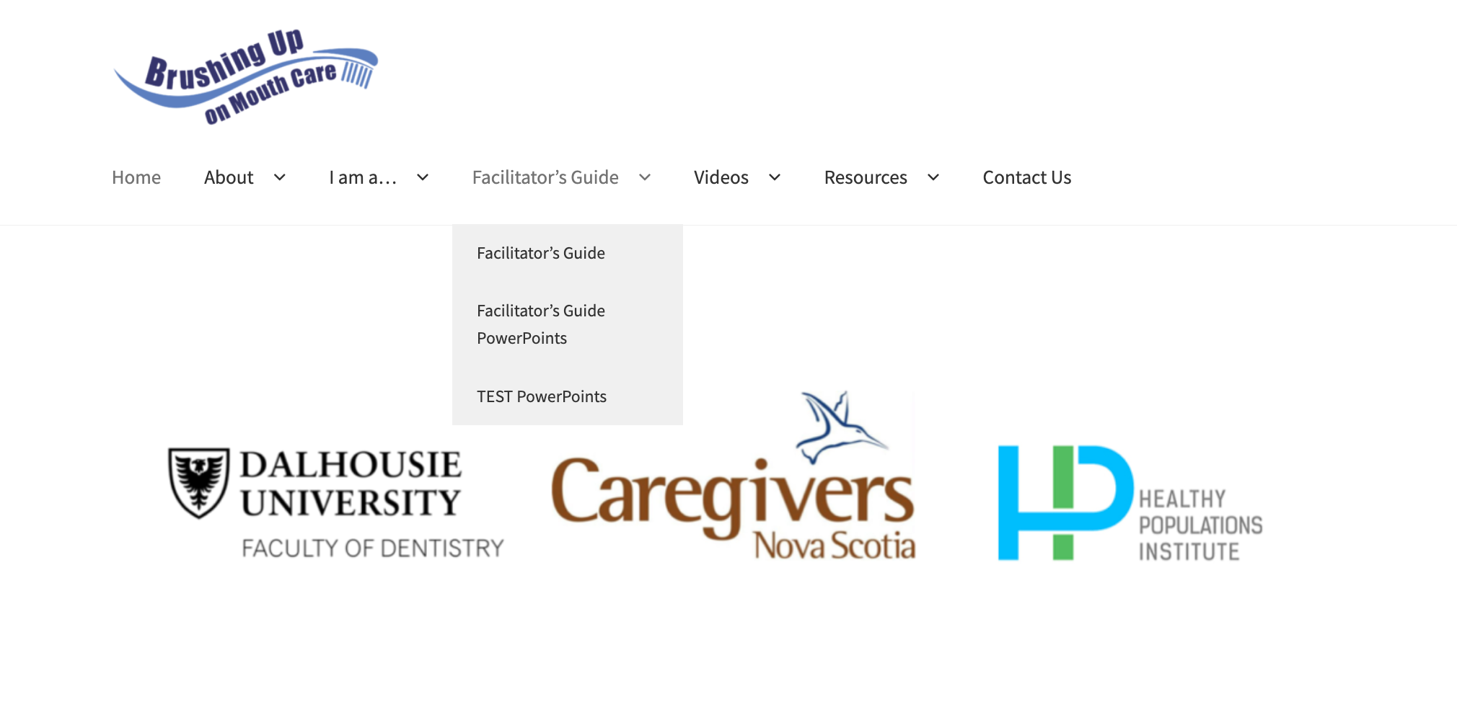
Tutorial
Brushing Up on Mouth Care: Online Program
Tab #3: ‘Facilitator’s Guide’
Notes:
Onto the ‘facilitator’s guide’ tab, you will notice there are two sub-tabs. Under these sub-tabs, you will find program materials which can be downloaded or printed from your computer. To do this, click on the item you want to download, select where you want to save it, and then click ‘Save’. Note, however, that sometimes the file will automatically save to your downloads folder.

Slide 19
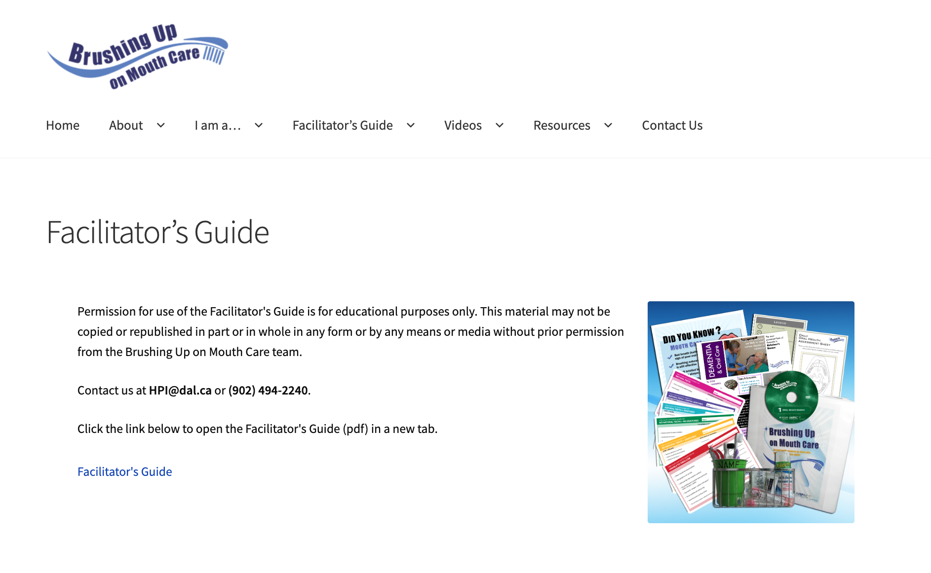
Tutorial
Brushing Up on Mouth Care: Online Program
Sub-Tab: Facilitator’s Guide
Notes:
The first sub-tab is where you will find the facilitator’s guide. This guide summarizes everything you need to know about facilitating an educational session and what should be covered in each by using the learning objectives as a guide.

Slide 20
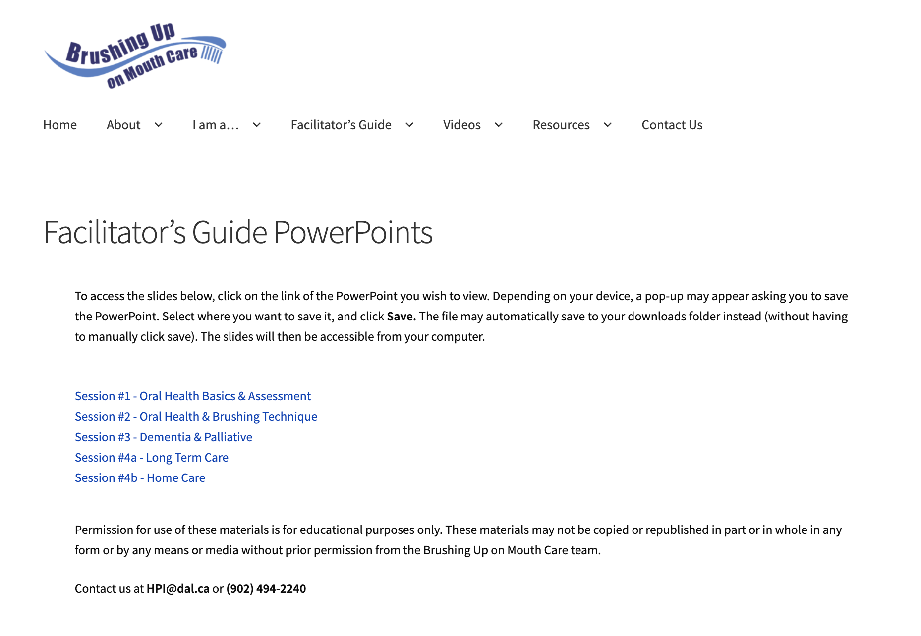
Tutorial
Brushing Up on Mouth Care: Online Program
Sub-Tab: Facilitator’s Guide PowerPoints
Notes:
The second sub-tab provides all the PowerPoint presentations, with complimentary notes. The PowerPoints explore topics on oral health basics and assessment, oral health and brushing technique, dementia and palliative care, long-term care, as well as home care.

Slide 21
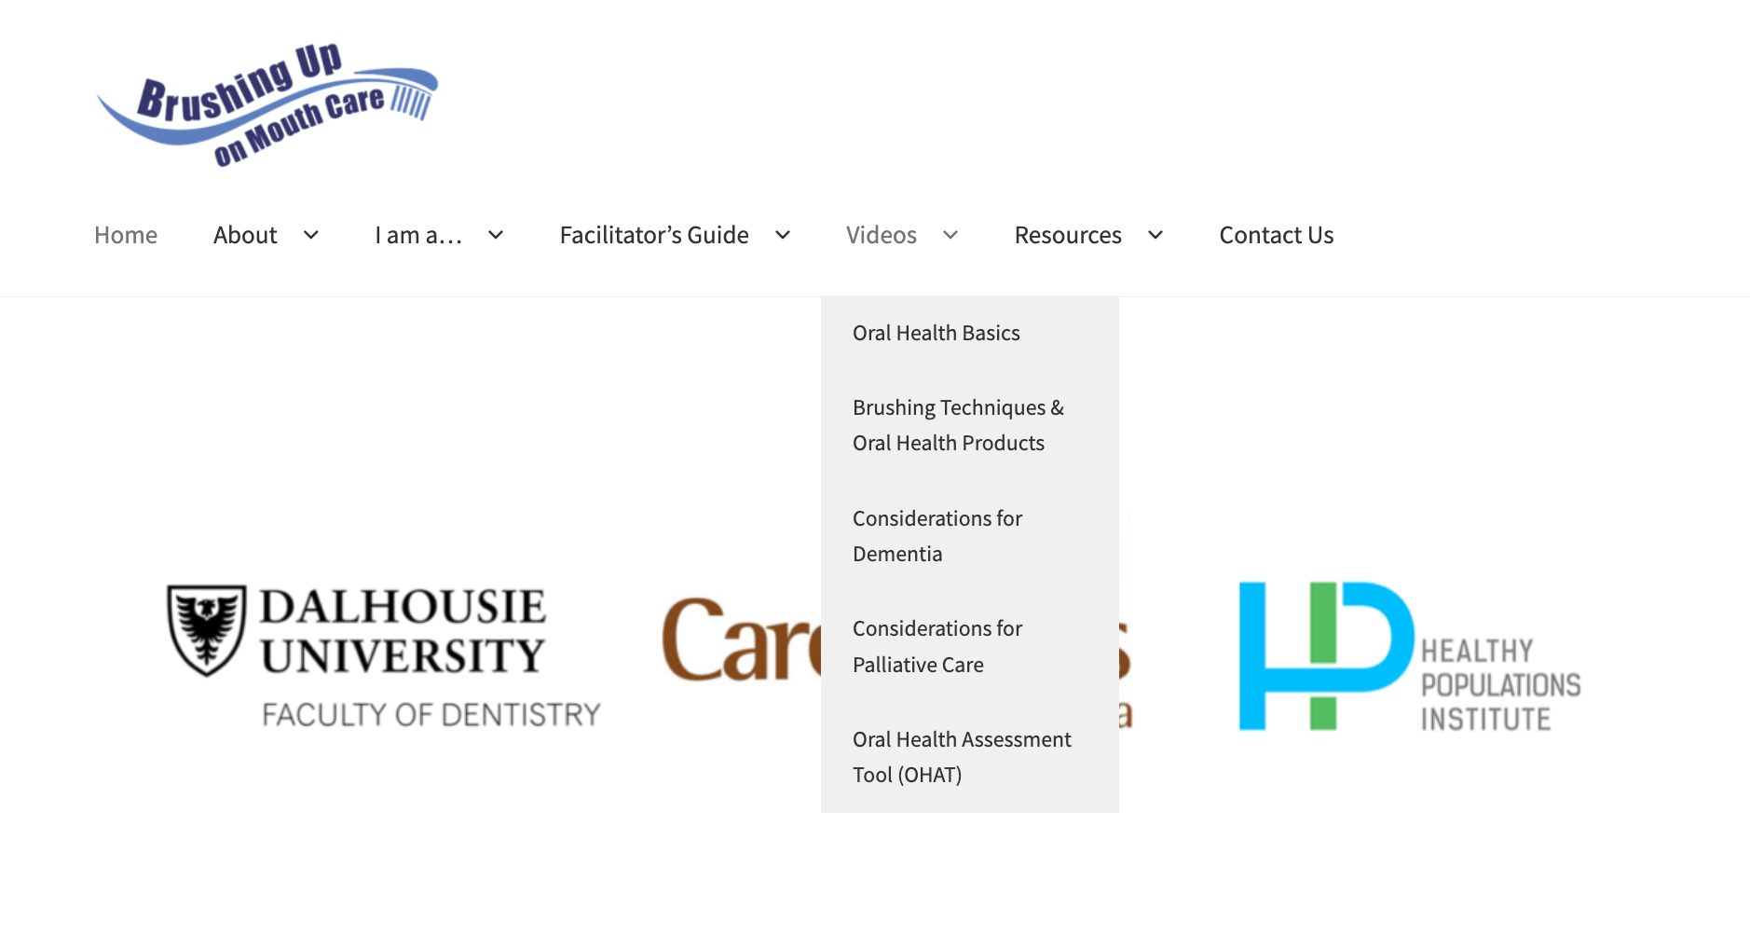
Tutorial
Brushing Up on Mouth Care: Online Program
Tab #4: ‘Videos’
Notes:
Next, we will explore the ‘videos’ tab. Viewing these videos is highly recommended since they contain additional information not covered in the slides.
Under this tab, there are five sub-tabs – each of which have a series of videos you can watch by simply clicking the video title you wish to view. Before we look at each sub-tab, please note that there is a full video, in addition to mini clips of parts of that video. This makes it easy for you to revisit a topic. You will also notice there are opportunities at the end of each video for you to test your knowledge. Take advantage of this so you can determine where the gaps in your learning may have occurred.

Slide 22
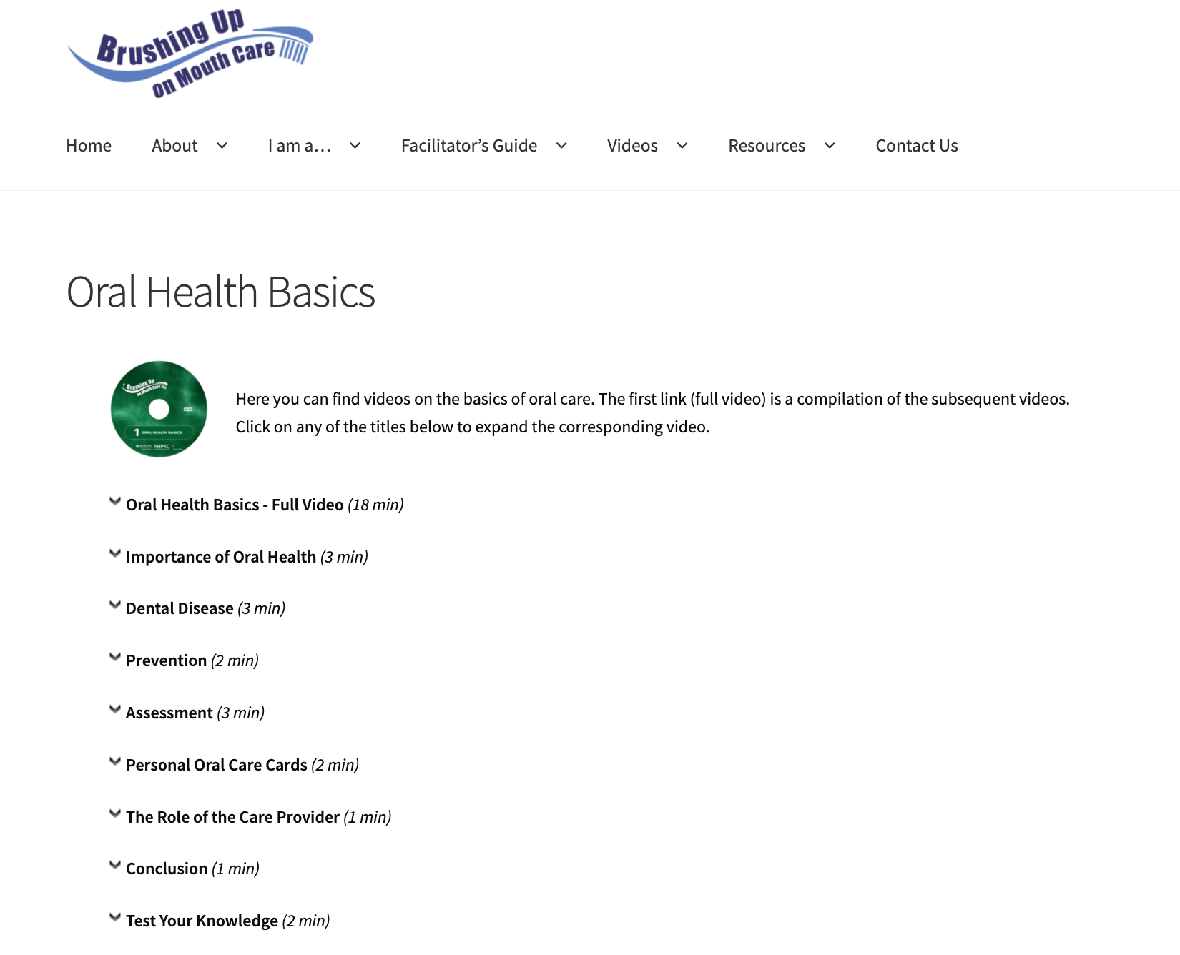
Tutorial
Brushing Up on Mouth Care: Online Program
Sub-Tab: Oral Health Basics
Notes:
Clicking on ‘oral health basics’, you will find videos on the importance of oral health, dental disease, prevention, assessment, personal oral care cards, and the role of the care provider.

Slide 23
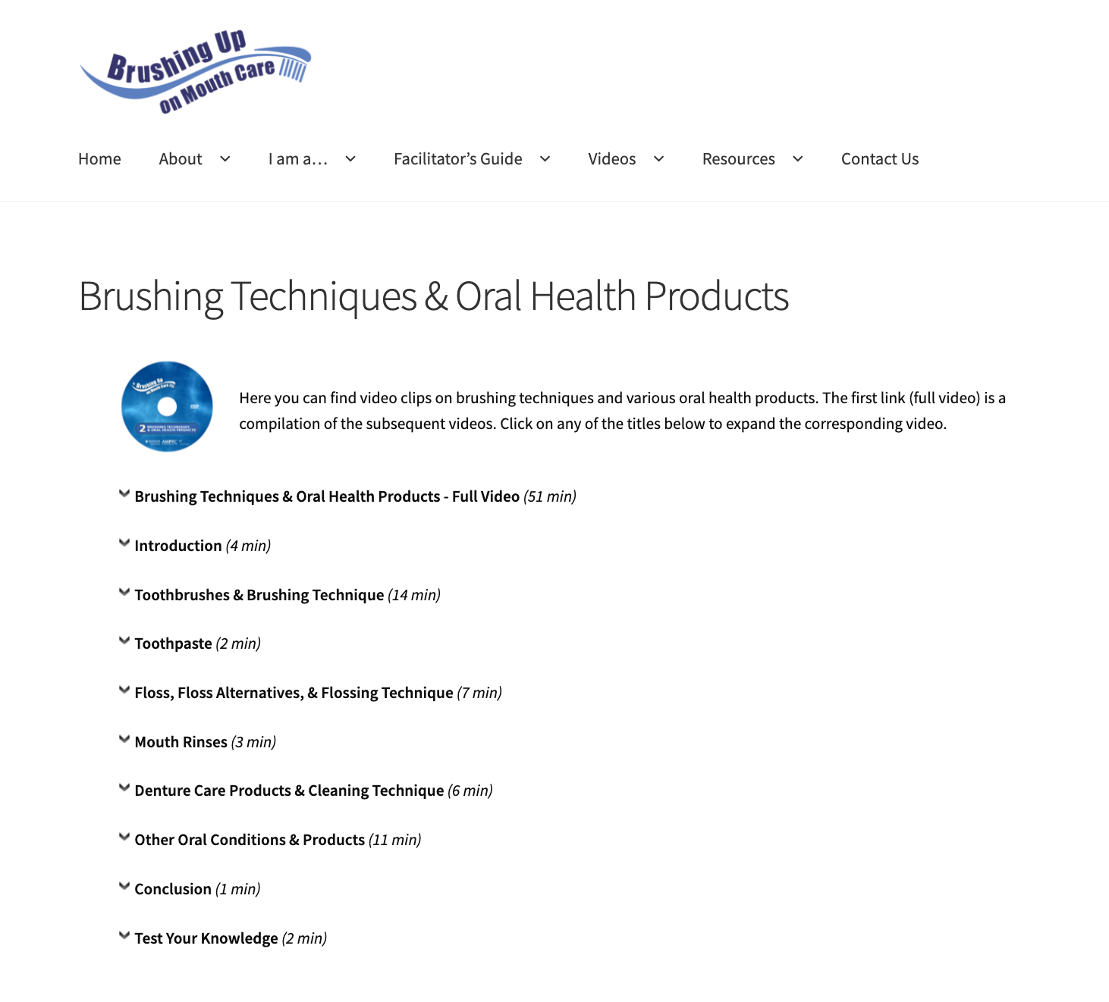
Tutorial
Brushing Up on Mouth Care: Online Program
Sub-Tab: Brushing Techniques and Oral Health Products
Notes:
Clicking on ‘brushing techniques and oral health products, you will find videos on topics such as toothbrushes and brushing techniques, toothpaste, flossing, mouth rinses, dentures, and products for other oral conditions.

Slide 24
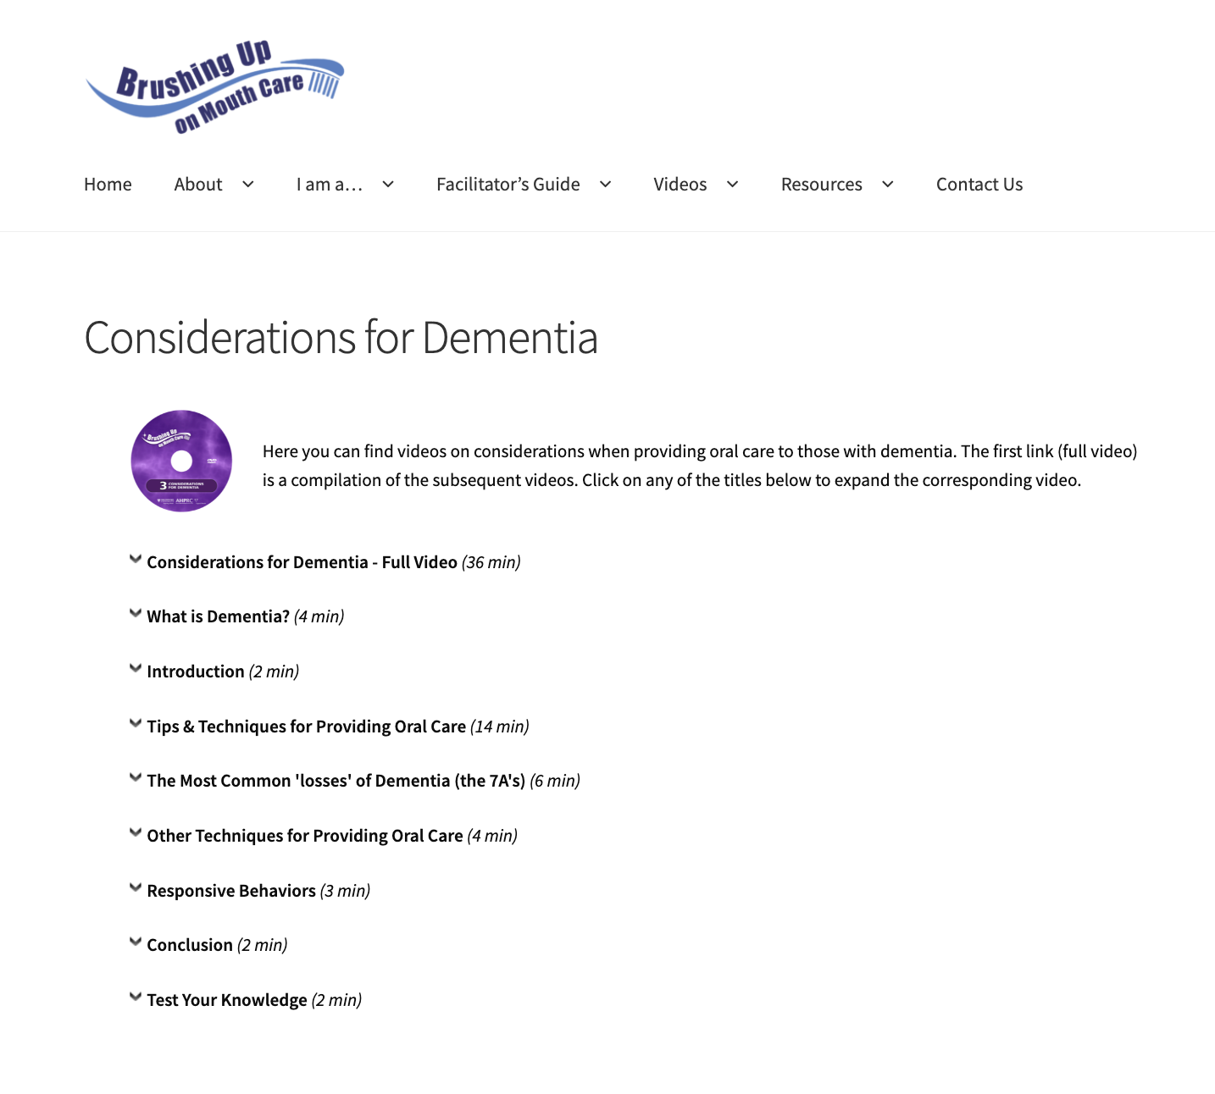
Tutorial
Brushing Up on Mouth Care: Online Program
Sub-Tab: Considerations for Dementia
Notes:
Clicking on ‘considerations for dementia’ provides you with information on what dementia is, the impact of dementia as it relates to oral care, how to provide effective oral care for this population, and strategies for better communication and managing challenging behaviour.

Slide 25
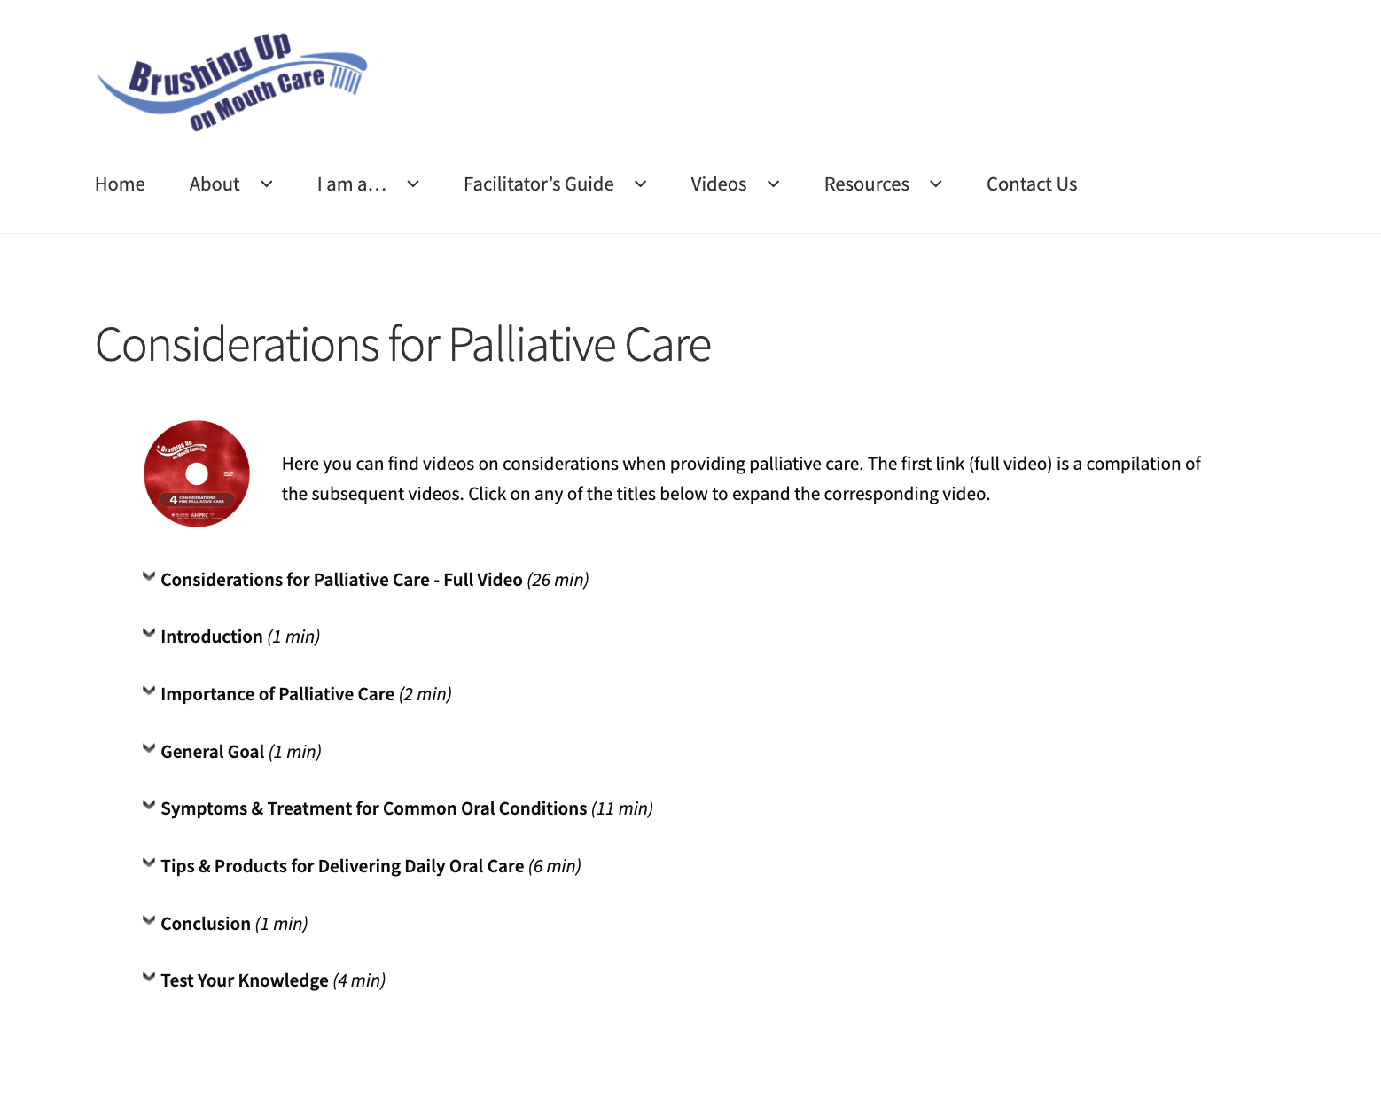
Tutorial
Brushing Up on Mouth Care: Online Program
Sub-Tab: Considerations for Palliative Care
Notes:
Clicking on ‘considerations for palliative care’ leads you to videos on the importance and general goal of palliative care, oral conditions that are common to persons in palliative care and oral care modifications that can help increase patient comfort.

Slide 26
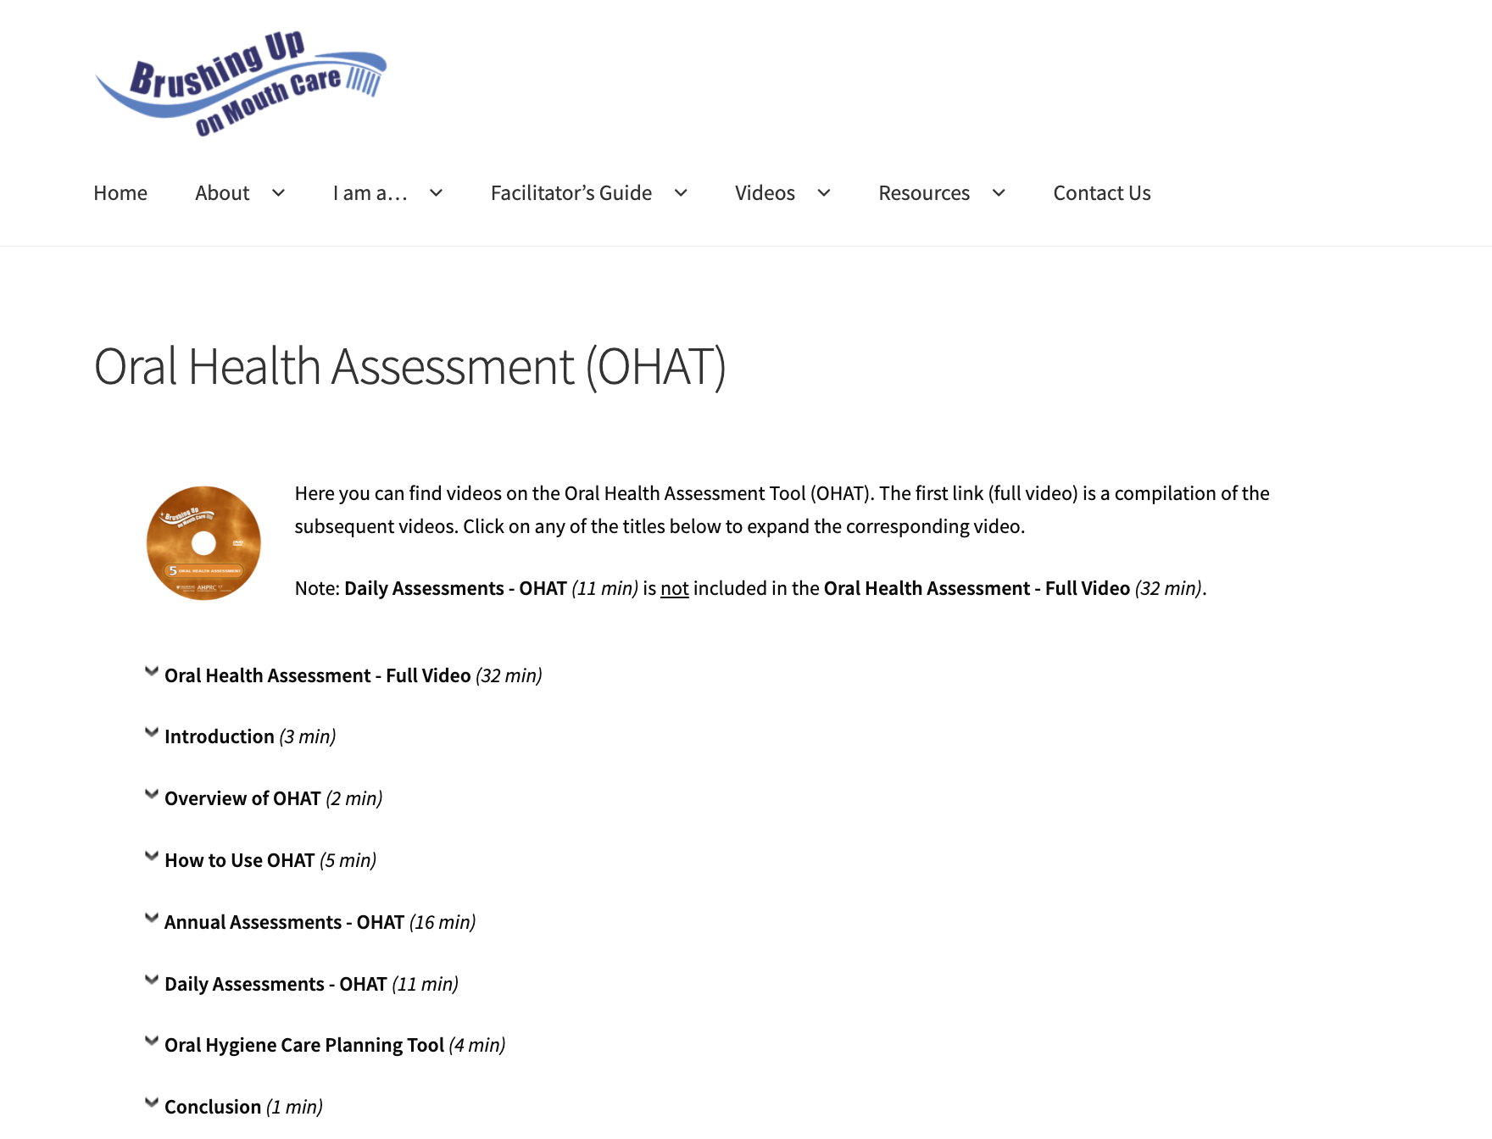
Tutorial
Brushing Up on Mouth Care: Online Program
Sub-Tab: Oral Health Assessment Tool (OHAT)
Notes:
Finally, clicking on ‘oral health assessment tool’ brings you to videos that provide an overview of the tool and instructions on how to use it. The video also explains the difference between annual and daily oral health assessments, and how to use the oral hygiene care planning tool.

Slide 27
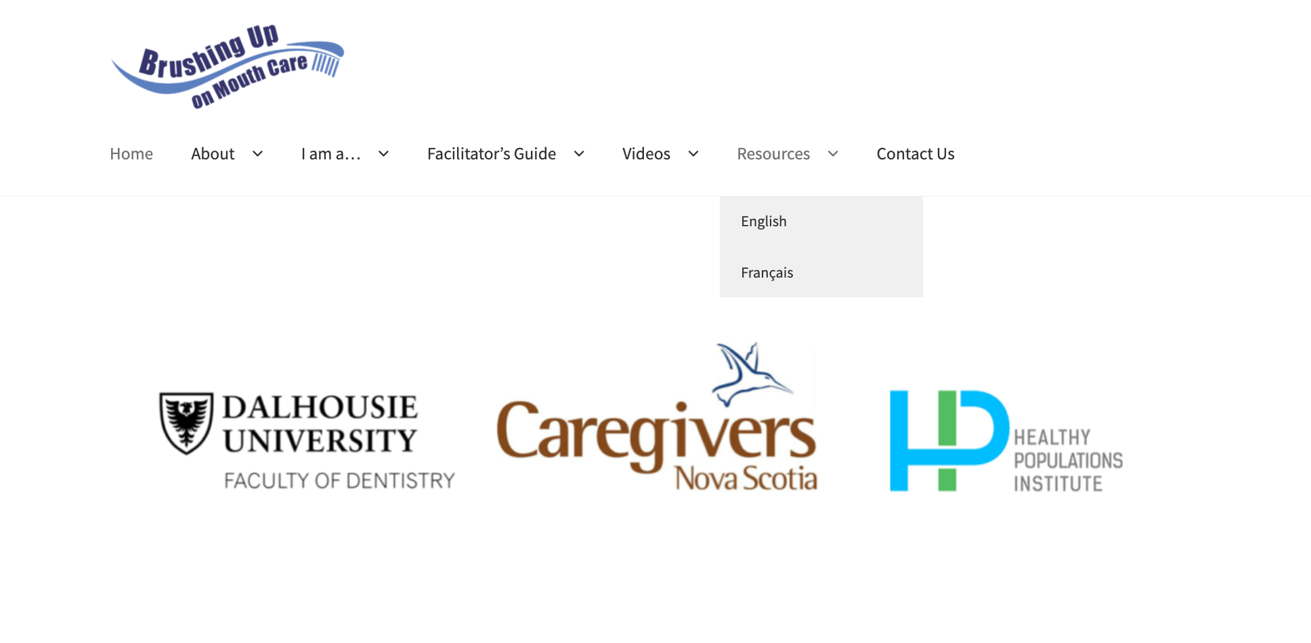
Tutorial
Brushing Up on Mouth Care: Online Program
Tab #5: ‘Resources’
Notes:
The last main tab we will explore is entitled ‘resources’. Note that these resources are provided in both English and French. Select the option that best applies to you. For the purposes of this presentation, we will select English.

Slide 28
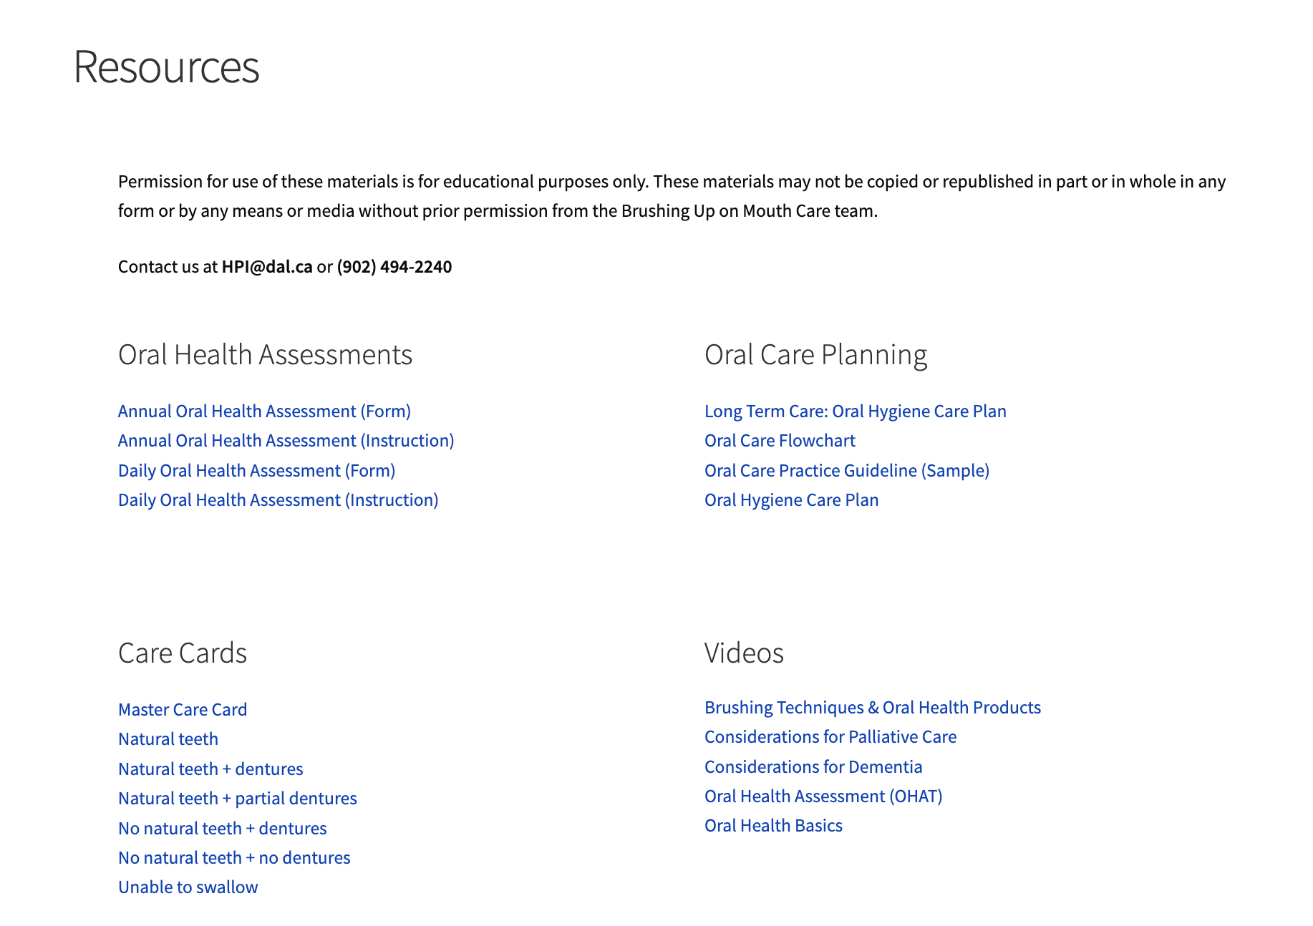
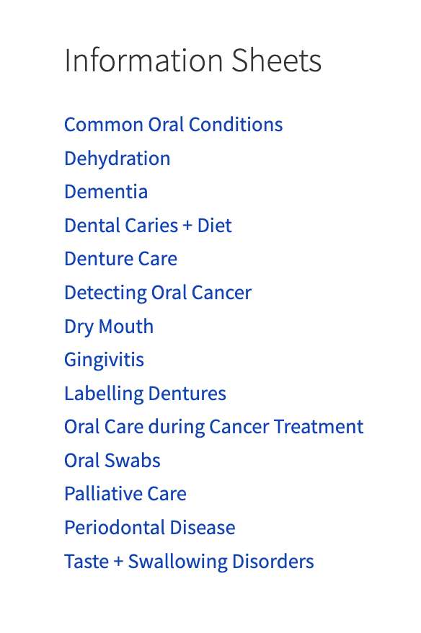
Tutorial
Brushing Up on Mouth Care: Online Program
Tab #5: ‘Resources’ Continued…
Notes:
Under this tab, you will find an organized list of all program materials. Note, we have already encountered some of these resources. For example, the videos and the oral health assessment and oral care planning documents. However, you should know that this tab also provides additional resources pertaining to care cards, tips on product use, and information on topics including, but not limited to, common oral conditions, dehydration, dementia, dental caries and diet, denture care, detecting oral cancer, dry mouth, and taste and swallowing disorders. Clicking on these blue titles will bring up PDFs which can be downloaded or printed.

Slide 29
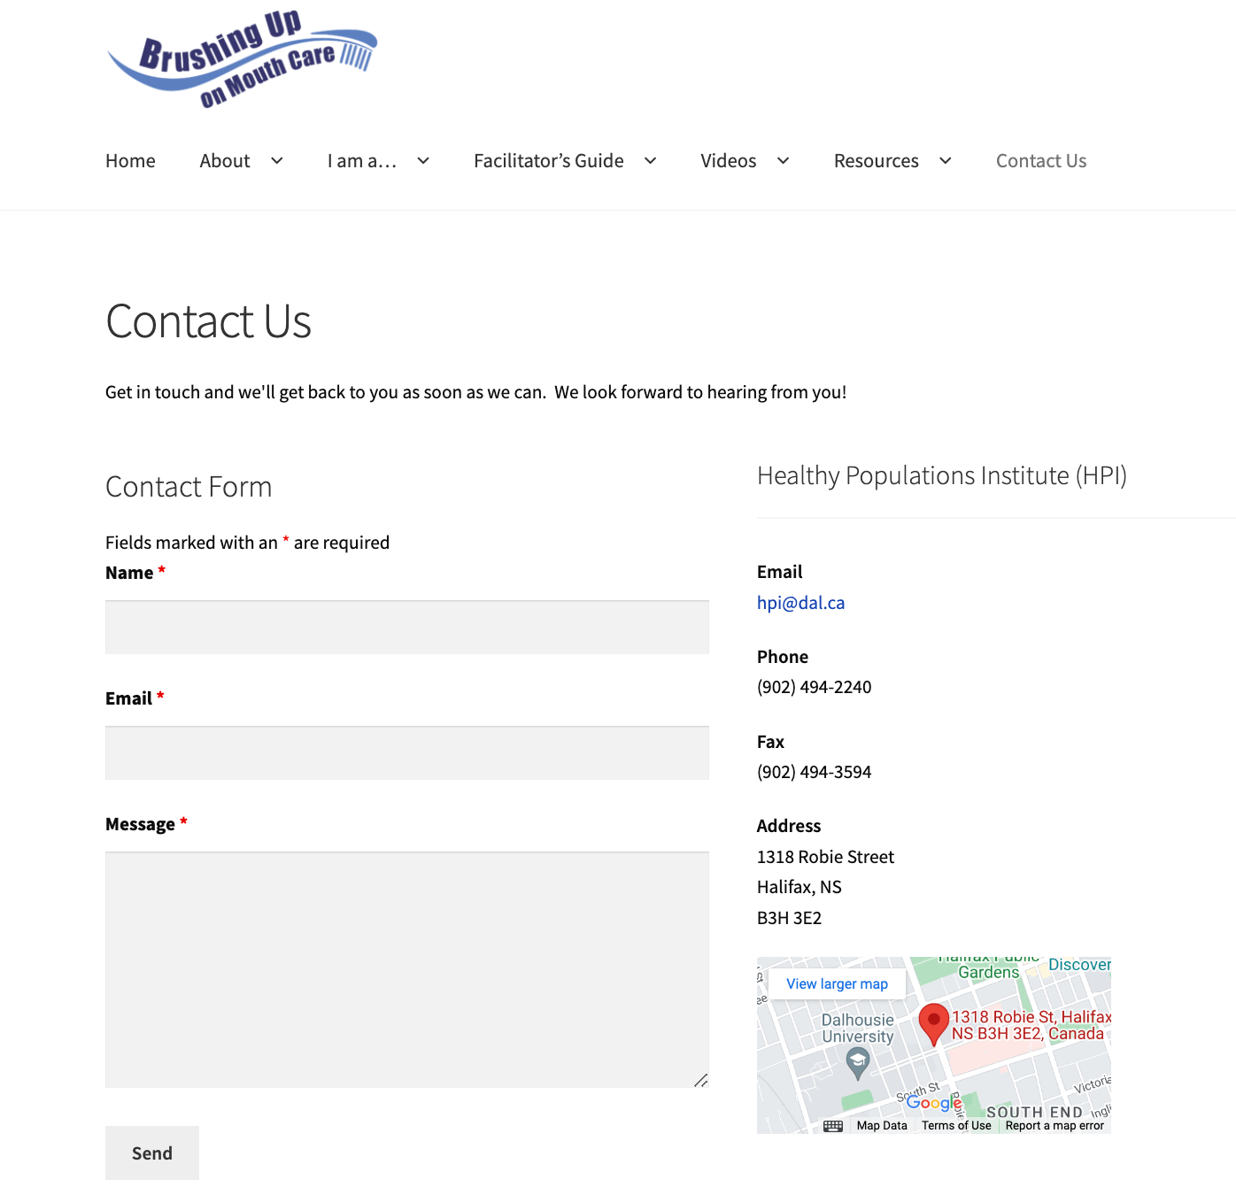
Tutorial
Brushing Up on Mouth Care: Online Program
Tab #6: ‘Contact Us’
Notes:
Now that all the main tabs have been explored, I want to direct your attention to the ‘contact us’ page. This page allows you to contact the ‘Brushing Up on Mouth Care’ team via email, phone, or using the online contact form. Whichever method you choose, the team is excited to hear from you and will respond to your message as soon as possible.

Slide 30
Tutorial
Brushing Up on Mouth Care: Online Program
Expectations
Achievement of competency and confidence in providing optimal daily mouth care
Utilization of oral health care best practices
Achievement of Nova Scotia’s Long-Term Care Program Requirements
Notes:
In sum, there are many benefits to using the ‘Brushing Up on Mouth Care’ program. For one, users can expect to achieve competency in each of the learning objectives so that they are knowledgeable and confident in providing optimal daily mouth care to their patients and/or loved ones. Second, the program promotes the utilization of oral care best practices. And third, the program helps care staff meet and maintain Nova Scotia’s Long-Term Care Program Requirements. Collectively, these factors can facilitate improved health and wellbeing for all individuals, and especially, older adults in continuing care facilities.

